Slide 1
Michigan Community Colleges Annual Data Workshop July 31, 2015
IPEDS UPDATE AND DISCUSSION

Slide 2
IPEDS 2015-16 DATA COLLECTION SCHEDULE
2015-16 | Registration | Fall 6 weeks | Winter 9 weeks | Spring 17 weeks
Collection Opens | August 5 | September 2 | December 9 | December 9
Collection Closes for Keyholders |  | October 14 | February 10 | April 6
Collection Closes for Coordinators |  | October 28 | February 24 | April 20
Components included | Registration; Report Mapping; Institution ID; IC-Header; | Institutional Characteristics; Completions; 12-month Enrollment; | Student Financial Aid; Graduation Rates; 200% Graduation Rates; Admissions; Outcome Measures; | Fall Enrollment; Finance; Human Resources; Academic Libraries;
Preliminary Data available in the IPEDS Data Center* |  | Mid-May | Mid-September | Mid-October
Notes:
This is the 2015-16 Data Collection schedule, available in the “Data Submission Info” area in the “Report Your Data” section of IPEDS. It is available without logging in to the IPEDS Data Collection system.

Slide 3
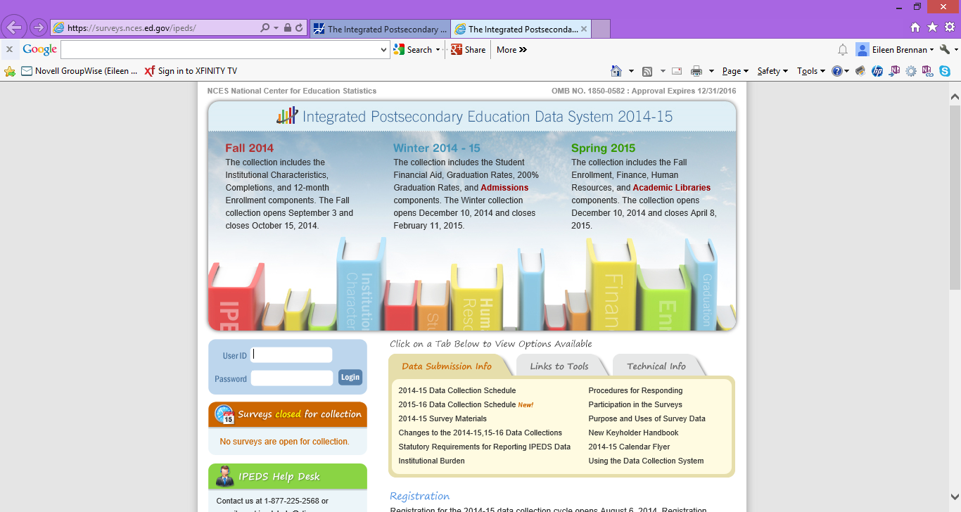
Notes:
The 2015-16 survey materials should be available in this area when the collection opens, August 5. Note the address, https: surveys.nces.ed.gov/ipeds.

Slide 4
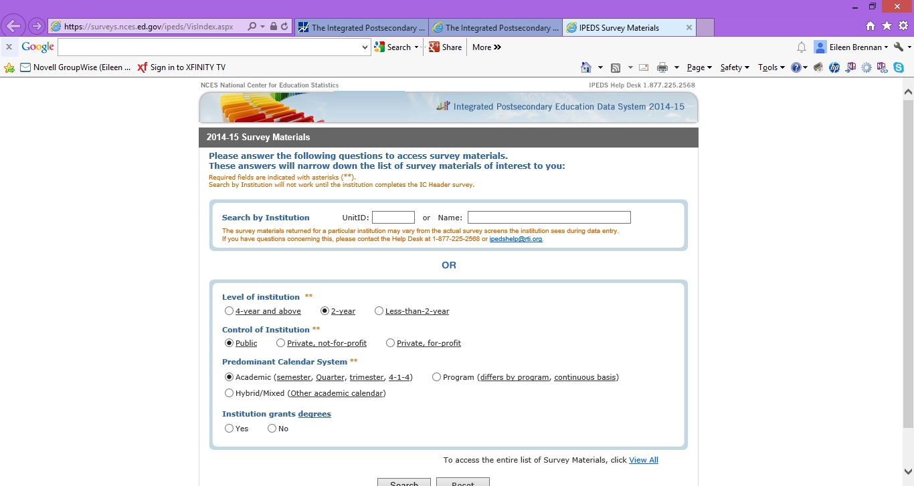
Notes:
Survey materials are available for viewing without logging in. You can search using an institution name, or by selecting institution type.

Slide 5
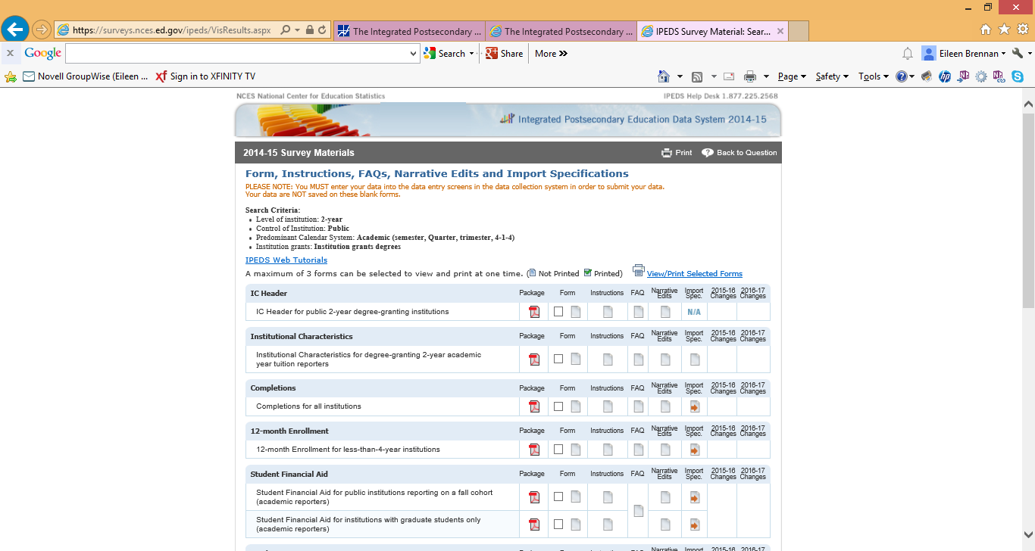
Notes:
This is the beginning of the screen which appears after submitting information about type of institution or institution for which you want to view survey material instructions. Note that this screen reflects materials for 2014-15 data collection.

Slide 6
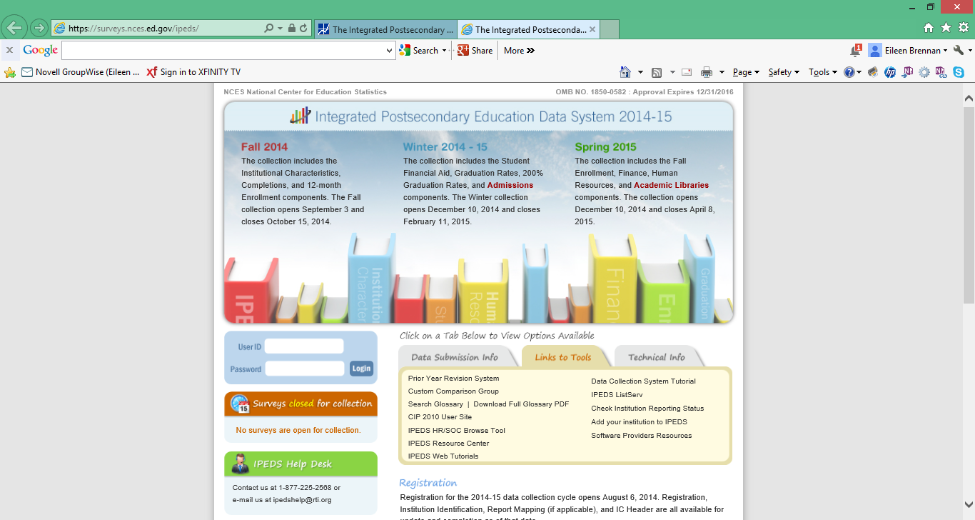
Notes:
Going back to the primary screen you can see links to other resources. A really good resources is the “New Keyholder Handbook” available in the Data Submission Info area. This is not only for New Keyholders! There are some very good explanations and information even the most experienced IPEDS reports might want to review.

Slide 7
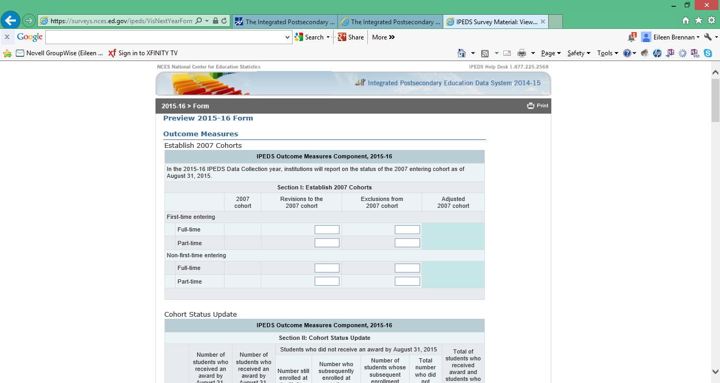
Notes:
The majority of the IPEDS Data Surveys for the 2015-16 Collection are not new. However, the Outcomes Measures Component is new for 2015-16. Those who have reported data for VFA (Voluntary Framework of Accountability) will find these measures somewhat familiar. The good news is that IPEDS only requires these measures at the highest levels – there is no disaggregation by program, race/ethnicity or other values used in other IPEDS reports. Note, however, that we will be reporting by all students attending our institutions for the first time (not those entering any college for the first time), and that we will be reporting on full and part time students, compared to reporting only on full-time students.
CAVEAT: This screen was selected from the 2014-15 survey materials, when this instruction was provided as a preview, not a requirement. There may be changes when the 2015-16 survey materials are published.

Slide 8
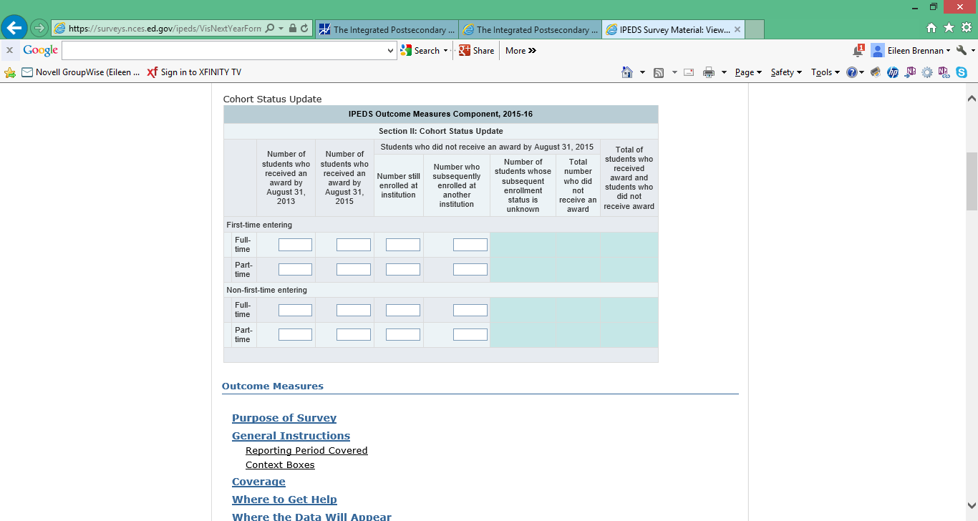
Notes:
This is a continuation of the screen.

Slide 9
NEW ISSUE: TWO-YEAR INSTITUTIONS OFFERING FOUR-YEAR DEGREES
Michigan two-year colleges may now offer select four-year degrees
These changes affect IPEDS data collection and benchmarking
IPEDS data are reflected in the IPEDS Data Center, College Navigator, and the College Affordability and Transparency Center

Slide 10
TWO-YEAR INSTITUTIONS OFFERING FOUR-YEAR DEGREES – IPEDS DATA COLLECTION AND REPORTING
Institution checks off Bachelor’s Degree as one of the award levels offered in the Institutional Characteristics Header Survey
All other survey forms are generated based upon responses to Institutional Characteristics Header Survey
Note that sector changes to “Public, 4-year or above” from “Public, 2-year”
Will be completing the Four-Year Institution Graduation Rate Survey

Slide 11
TWO-YEAR INSTITUTIONS OFFERING FOUR-YEAR DEGREES – BENCHMARKING
To look up data in the IPEDS Data Center on two-year colleges offering four-year degrees:
Identify institutions of interest by name or IPEDS Unit ID
Use the Carnegie Classification to identify institutions primarily offering associate’s degrees
DO NOT USE Sector

Slide 12
BENCHMARKING WITH TWO-YEAR INSTITUTIONS OFFERING FOUR-YEAR DEGREES
Carnegie Classification 2010: Basic
Value | Label
1 | Associate's--Public Rural-serving Small
2 | Associate's--Public Rural-serving Medium
3 | Associate's--Public Rural-serving Large
4 | Associate's--Public Suburban-serving Single Campus
5 | Associate's--Public Suburban-serving Multicampus
6 | Associate's--Public Urban-serving Single Campus
7 | Associate's--Public Urban-serving Multicampus
8 | Associate's--Public Special Use
9 | Associate's--Private Not-for-profit
10 | Associate's--Private For-profit
11 | Associate's--Public 2-year colleges under 4-year universities
12 | Associate's--Public 4-year Primarily Associate's
13 | Associate's--Private Not-for-profit 4-year Primarily Associate's
14 | Associate's--Private For-profit 4-year Primarily Associate's
Notes:
To use IPEDS data comparing two-year colleges not offering four-year degrees to two-year colleges offering four-year degrees you will need to look at the Carnegie Classification available in the Institutional Characteristics section of the IPEDS Data Center variable selection.

Slide 13
COLLEGE AFFORDABILITY AND TRANSPARENCY CENTER
“The College Affordability and Transparency Center includes information for students, parents, and policymakers about college costs at America’s colleges and universities. The Center includes several lists of institutions based on the tuition and fees and net prices (the price of attendance after considering all grant and scholarship aid) charged to students. These lists meet requirements outlined in the Higher Education Act (HEA) of 1965, as amended, and will be updated annually and posted on the College Navigator website by July 1. “
Highest and lowest cost and change lists are based on reporting sector

Slide 14
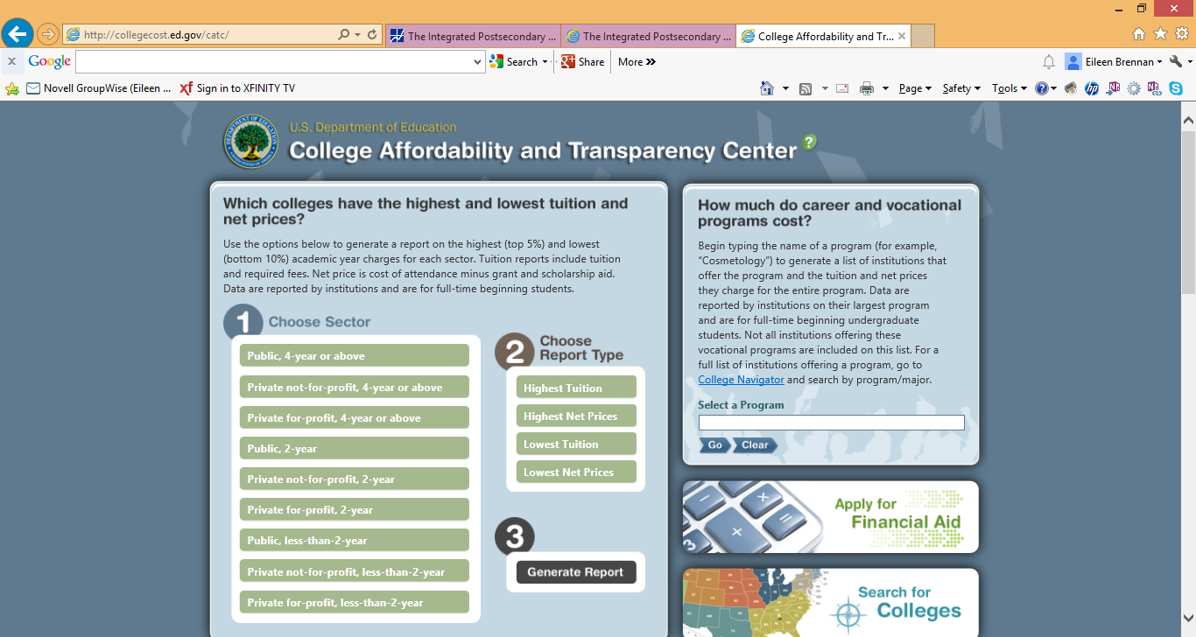
Notes:
This is the College Affordability and Transparency Center -- collegecost.ed.gov/catc. Lists of the lowest and highest costs by sector, as well as the highest changes in costs, appear here, and notice of these lists is pushed out annually.

